Slide 1
Predict underwriting score against Autism Spectrum Disorder in children, adolescents and adults
Predict underwriting score against
Autism Spectrum Disorder(ASD)
Rajesh Sharma

Slide 2
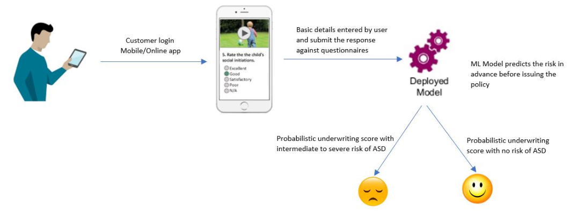
Underwriting Score prediction for ASD
Problem Background
In Canada, among children and youth from 5 to 17 years of age:
An estimated 1 in 66 have been diagnosed with Autism Spectrum Disorder(ASD)
Males were identified with ASD 4x more frequently than females
One in 42 males and one in 165 females were diagnosed with ASD
Solution
Using AWS SageMaker as a platform, Python3 and its other libraries built the ML model on the ASD Dataset for Children, Adolescents and Adults available on UCI ML Repository:
http://archive.ics.uci.edu/ml/datasets/Autism+Screening+Adult
http://archive.ics.uci.edu/ml/datasets/Autistic+Spectrum+Disorder+Screening+Data+for+Children++
http://archive.ics.uci.edu/ml/datasets/Autistic+Spectrum+Disorder+Screening+Data+for+Adolescent+++
Combined dataset contains 10 questionnaires variables and 9 supporting variables with a total of 1100 cases from various countries and ethnicities, and age group.
Problem Statement
As per the recent strategies of The Province of Canada, Ontario families with an autistic child receives $20,000 a year until their child turns six. After the age of six, families receives $5,000 a year until their child turns 18.
And, it is estimated that Ontario could add $952 million of insurance for autism services including Applied Behavioral Analysis (ABA) and speech/language therapy.
Solution Design
Business Impact
This model predicts the probabilistic underwriting score for health/disability/long term cure or disease insurances against ASD in Children, Adolescents and Adults
This score will help Sunlife in approving or rejecting the policy
By using a threshold value along with the model generated score helps the actuarial to fluctuate the premium amount based upon the case

Slide 3
ASD Health Care Expenditure
Below graphs are representing the Total Healthcare Expenditure for “Autism Spectrum Disorder”, “Autistic cases” and “other ASD disorders”.

Slide 4
Rise(%) in ASD Healthcare Expenditure
Below graphs are representing the percentage rise in Total Healthcare Expenditure for “Autism Spectrum Disorder”, “Autistic cases” and “other ASD disorders”.

Slide 5
ASD Prevalence
Below graphs are representing:
Top ASD prevalent countries
ASD Incidence rate by gender in Quebec, Canada

Slide 6
ASD ASIA Region Progression
Below bar charts are representing:
Number of ASD cases till 2008 and 2016
Percentage rise in number of cases from 2008 to 2016

Slide 7


